Slide 1
GENERAL INSURANCE
TEAM MEMBERS:
Divya Harchandani | Nand Nalawade
Gaurang Oza | Renita D’silva

Slide 2
Introduction

Slide 3
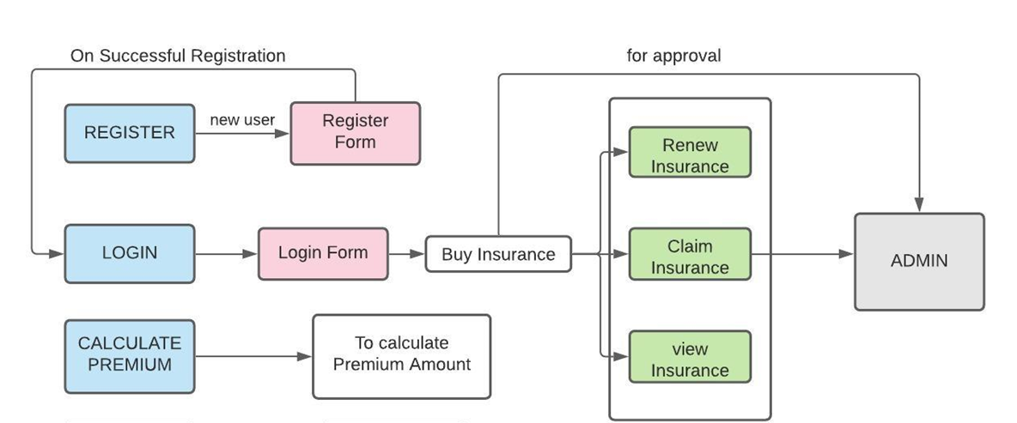
Flowchart:

Slide 4
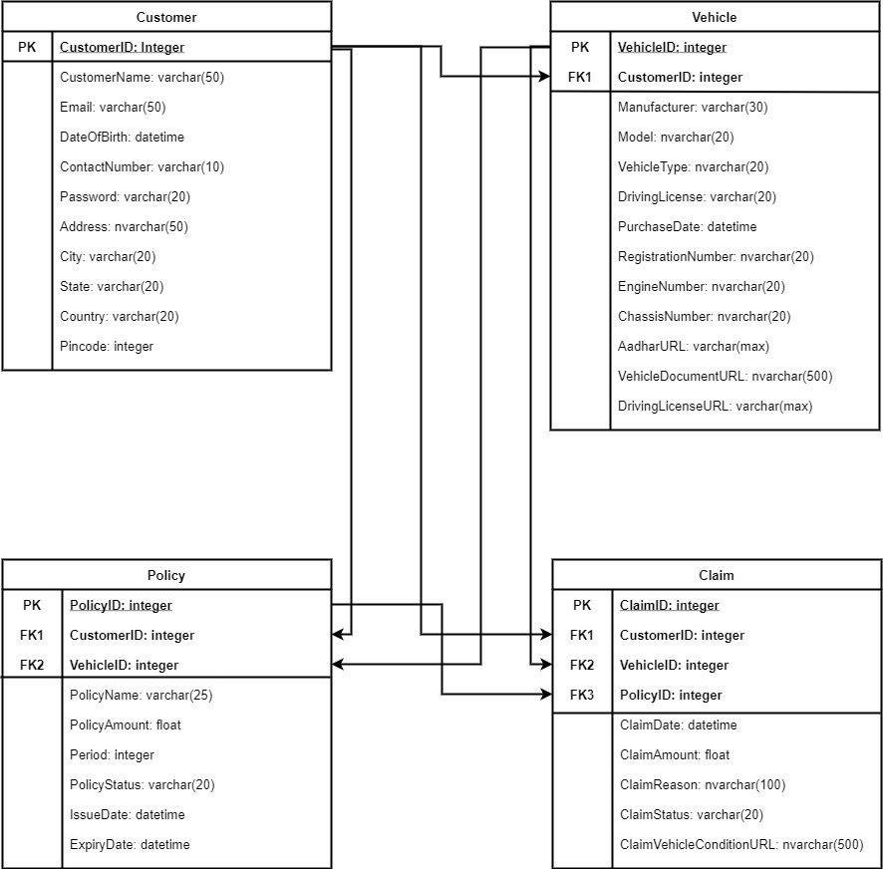
Database Design:

Slide 5
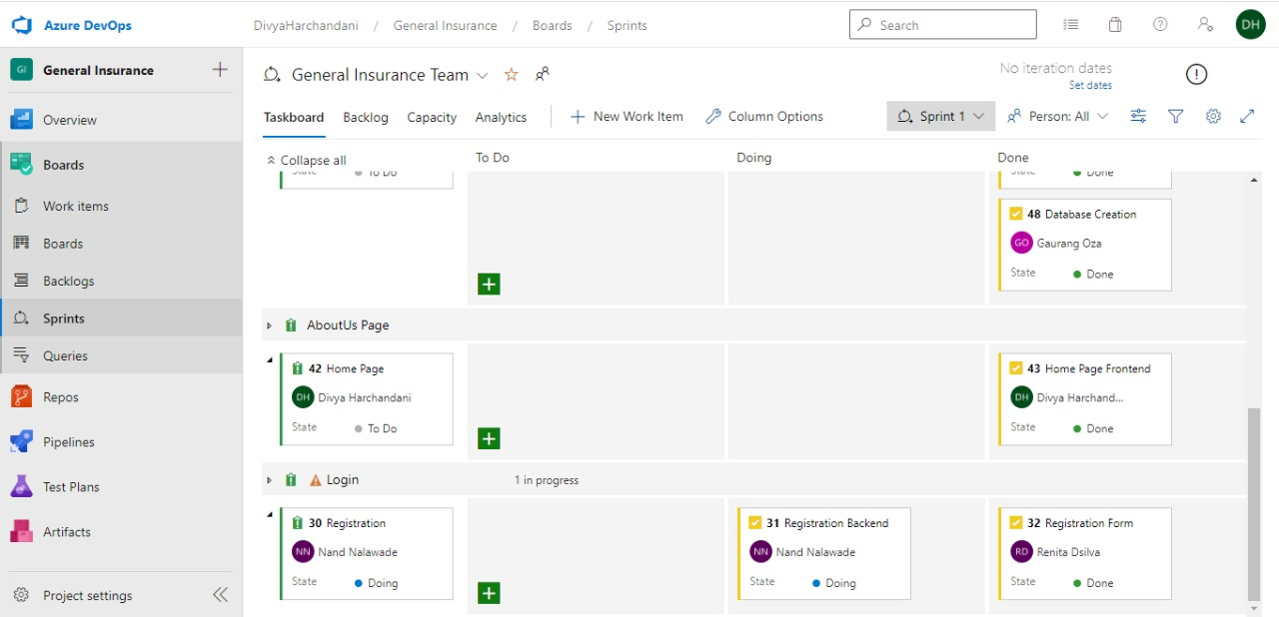
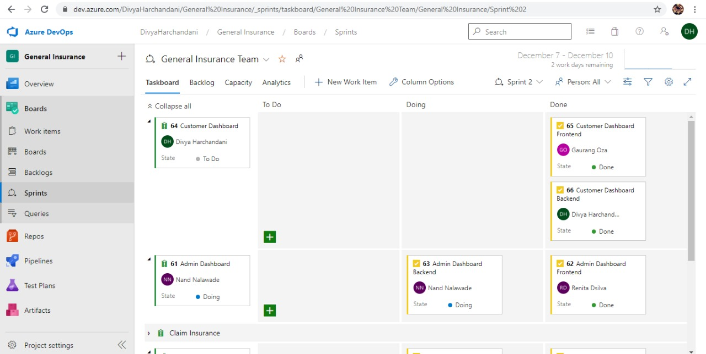
Sprint Phase:
Sprint 1
Sprint 2

Slide 6

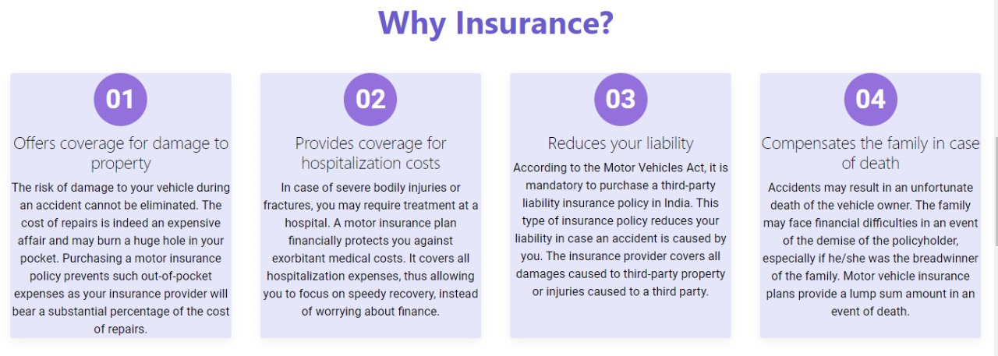


Home Page:

Slide 7
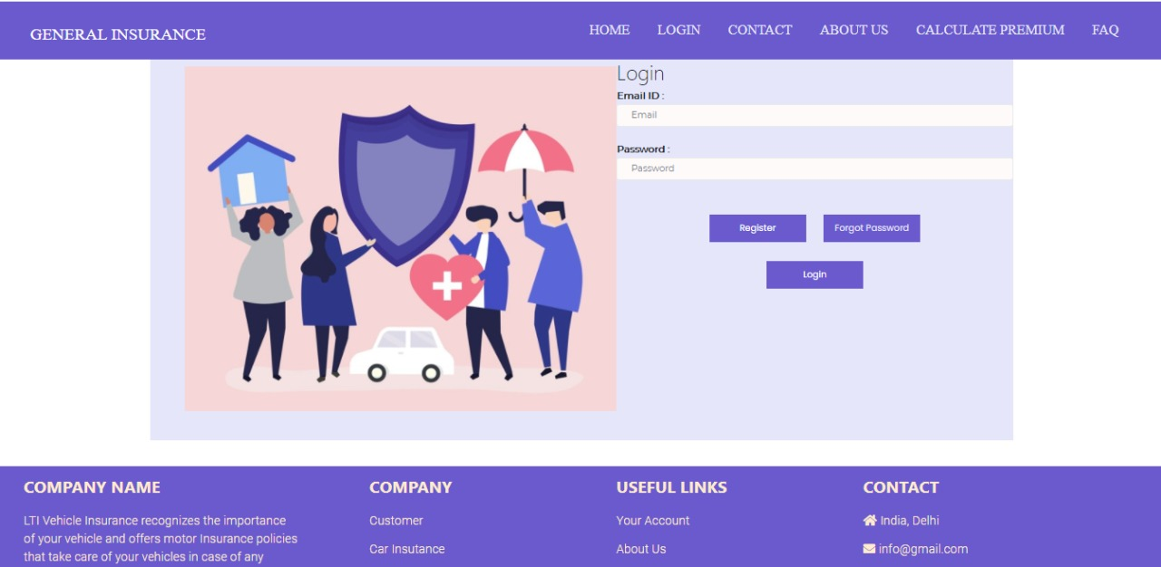
Login Page:

Slide 8
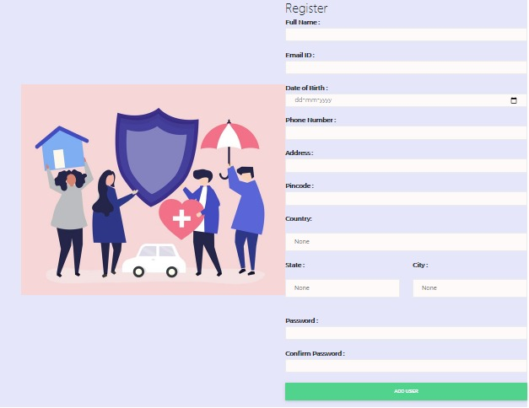
Registration Page:

Slide 9

Customer Dashboard:

Slide 10
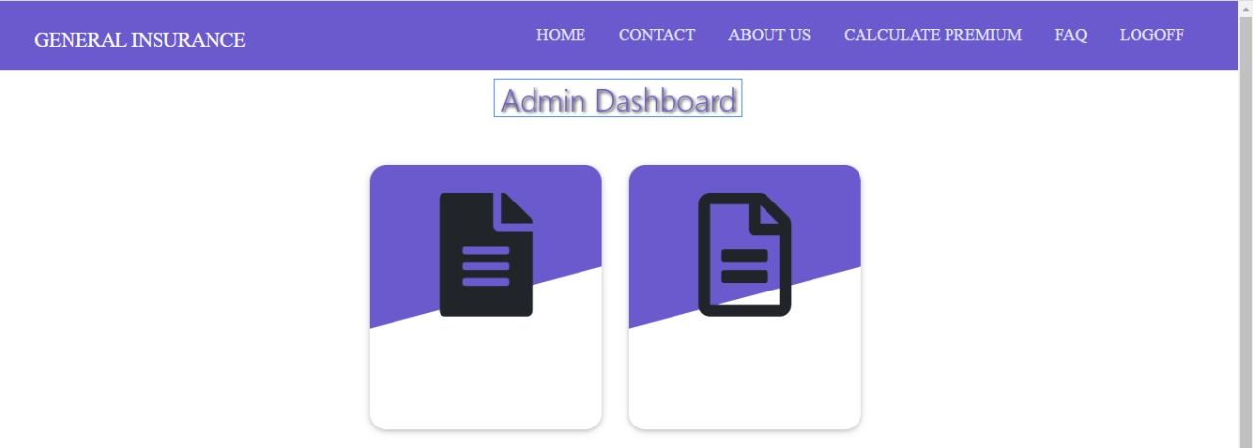
Admin Dashboard:

Slide 11
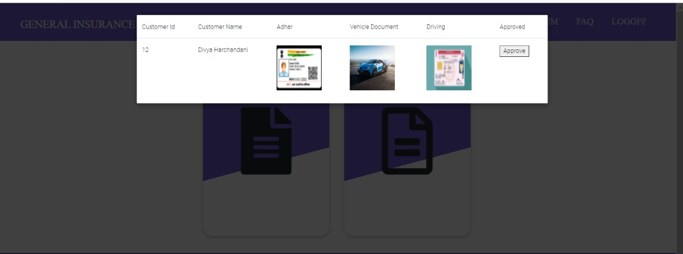
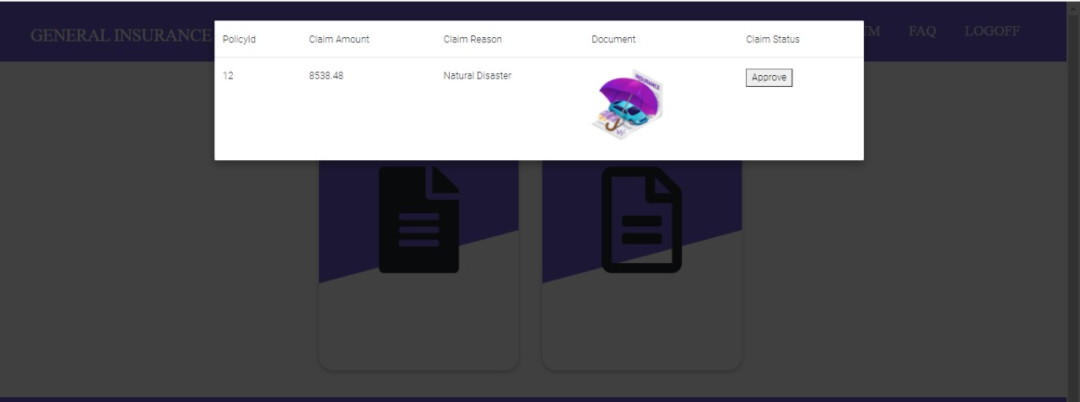
Admin Dashboard:

Slide 12
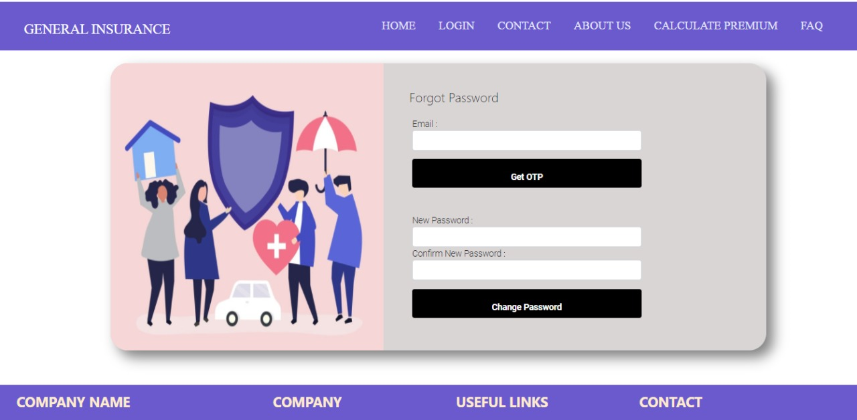
Forgot Password Page:

Slide 13
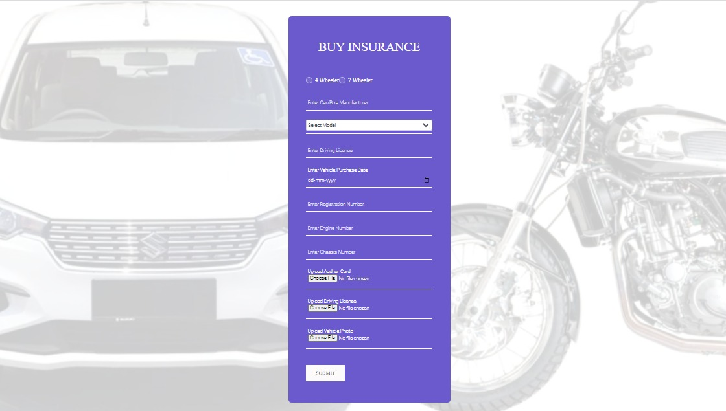
Buy Insurance Page:

Slide 14

Plans Page:

Slide 15
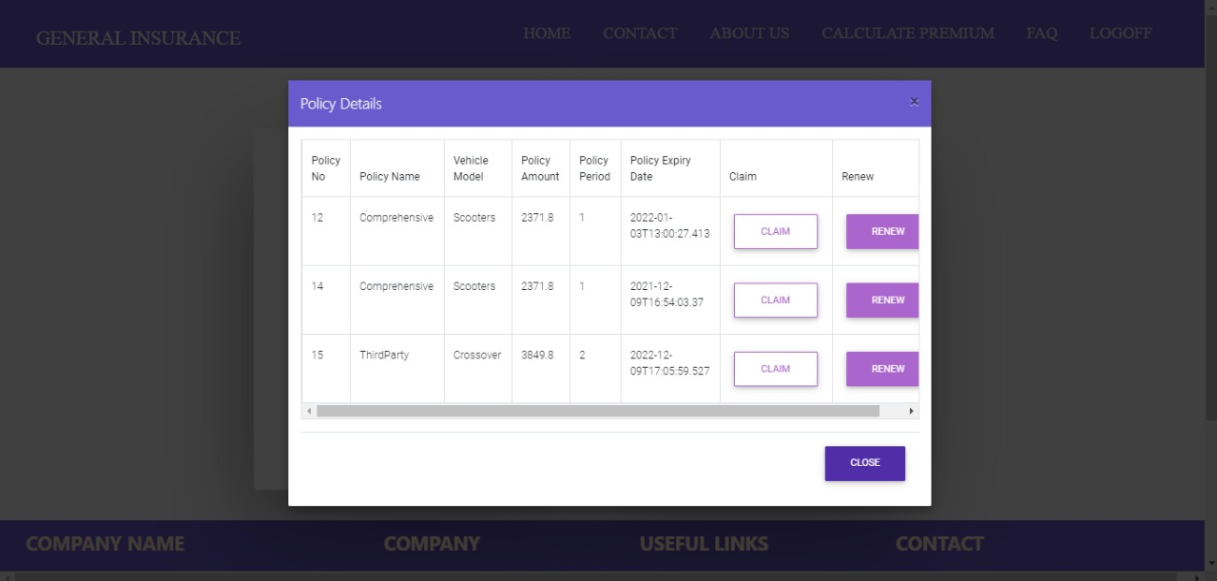
Policy Page:

Slide 16
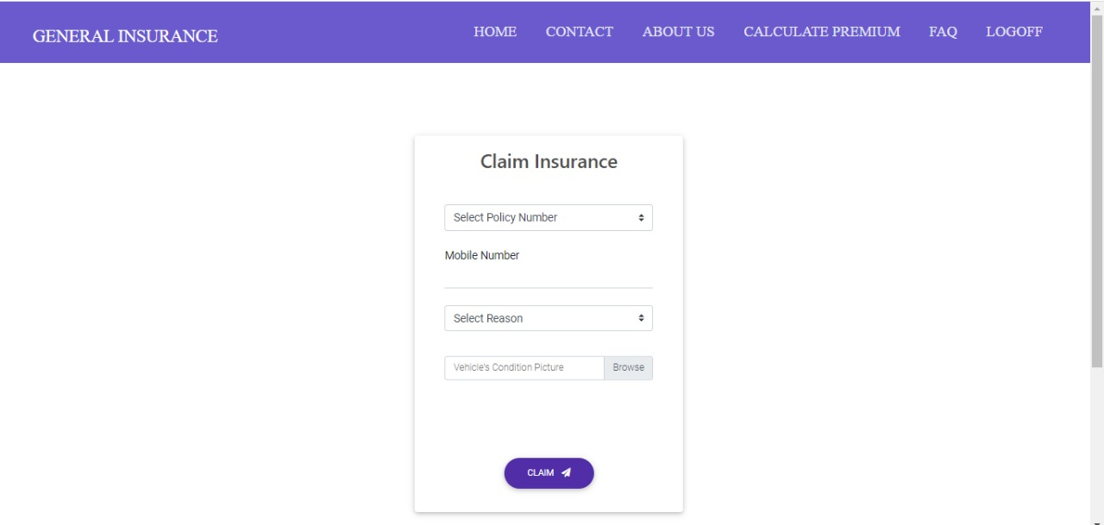
Claim Page:

Slide 17
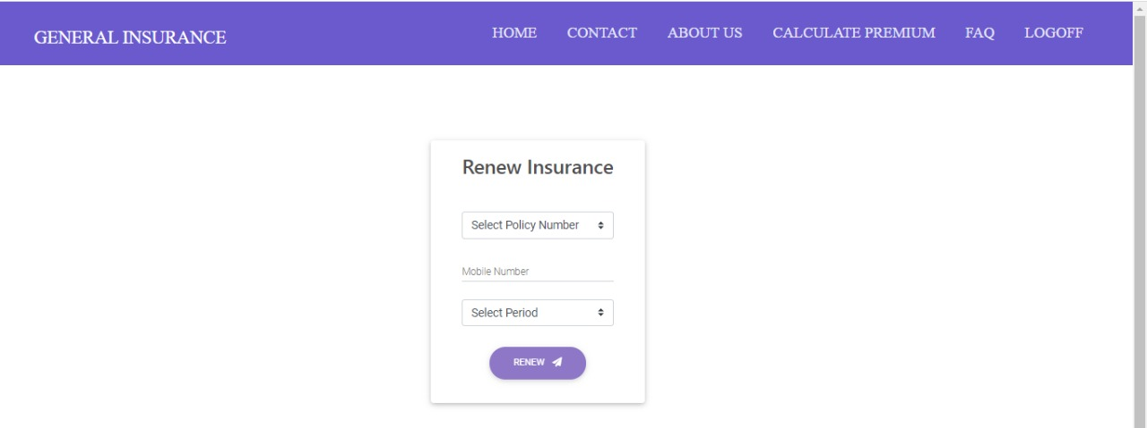
Renew Page:

Slide 18

Calculate Premium Page:

Slide 19
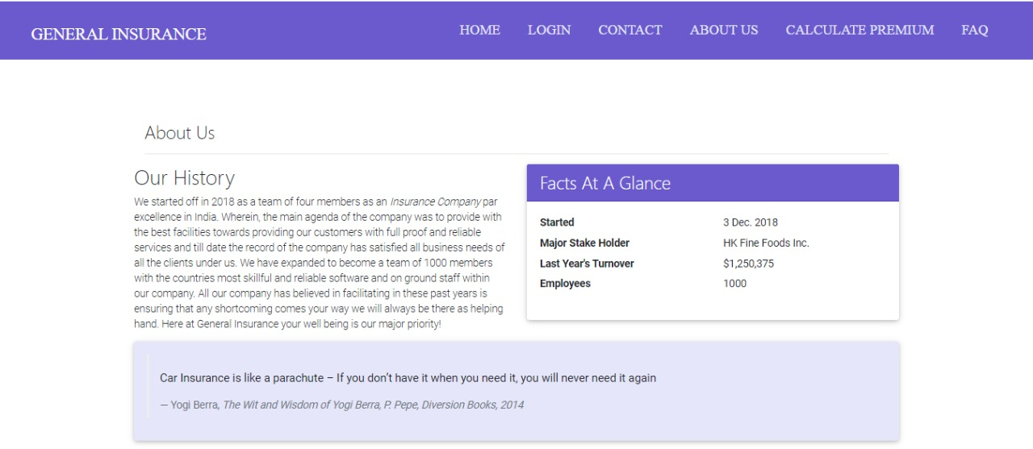
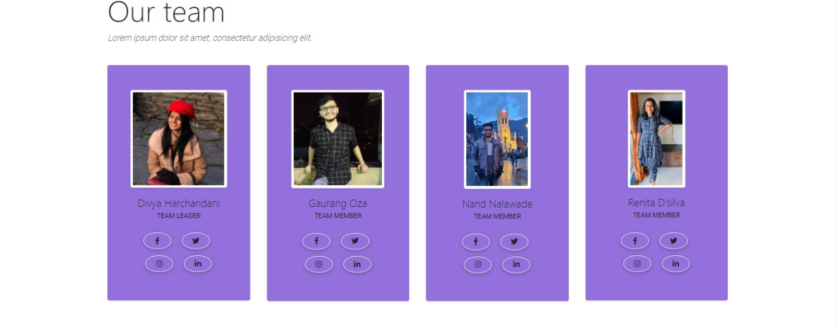
About Us Page:

Slide 20
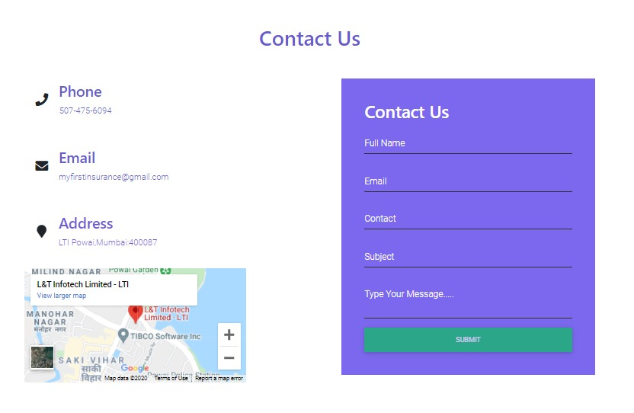
Contact Us:

Slide 21
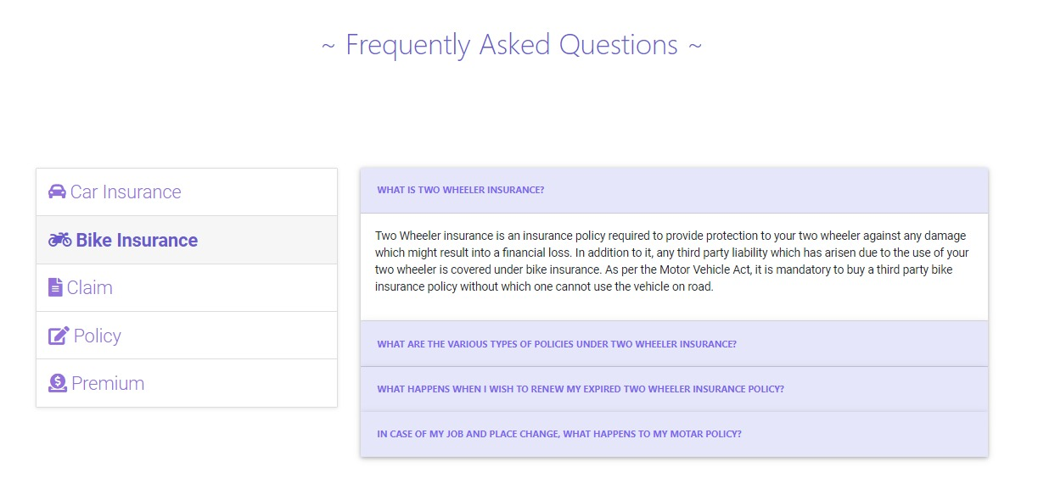
FAQ:

